Slide 1
Stanford ME469: Multiphysics Coupling
Stefan P. Domino
Computational Thermal and Fluid Mechanics
Sandia National Laboratories SAND2018-4536 PE

Slide 2
Multiphysics Coupling: Outline
Examples of multiphysics coupling with emphasis on fluids, PMR, and CHT
Monolithic vs Operator Split
Details of PMR/Fluids Coupling
Details of PMR/Thermal Coupling
Details of Fluids/Thermal Coupling
Verification
Stability
Conclusions

Slide 3
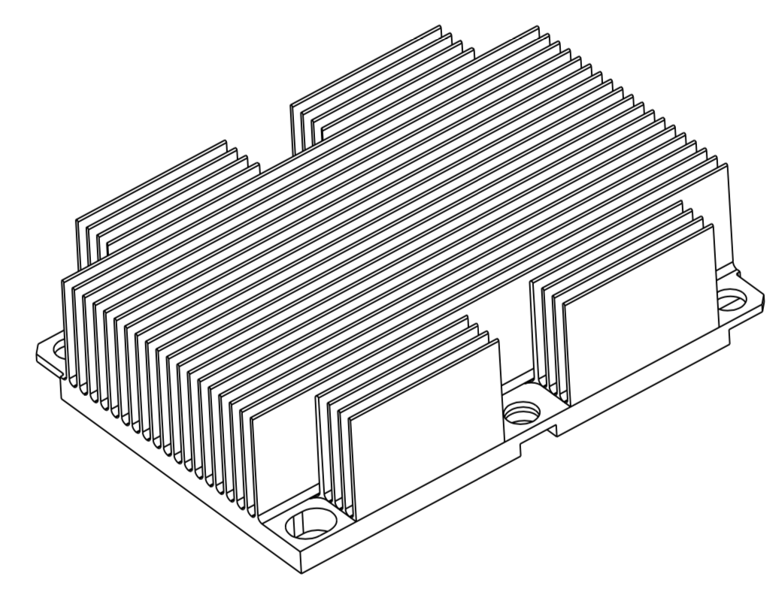
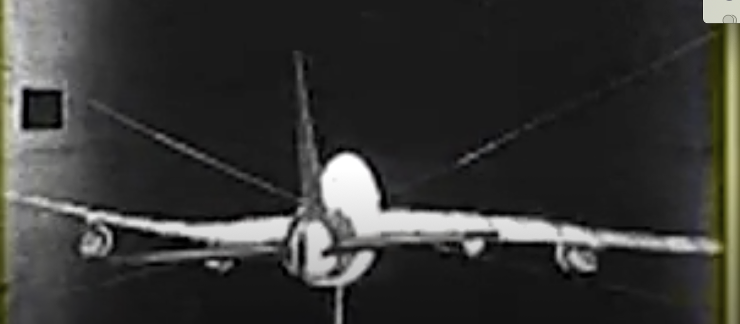

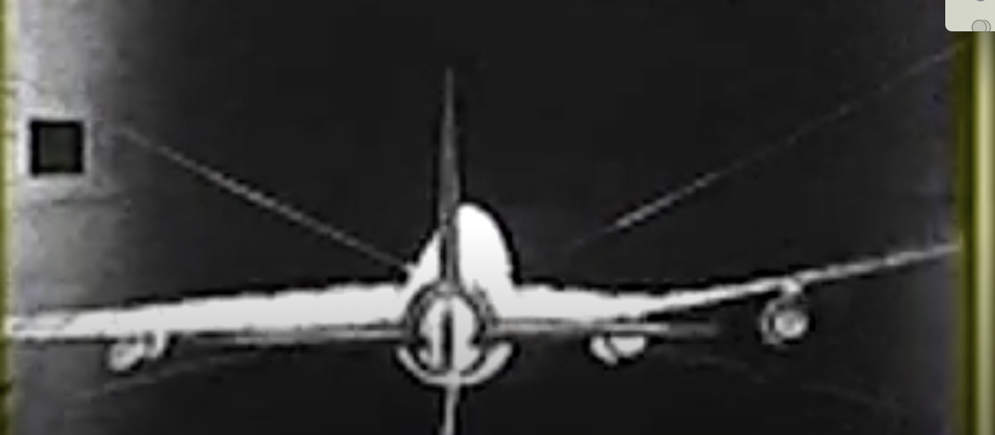
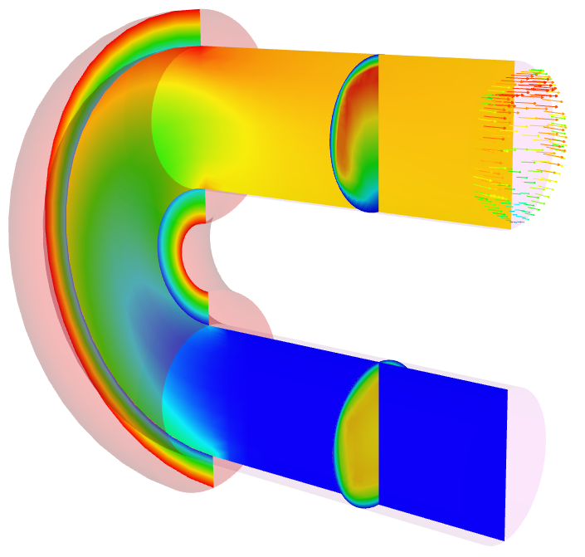
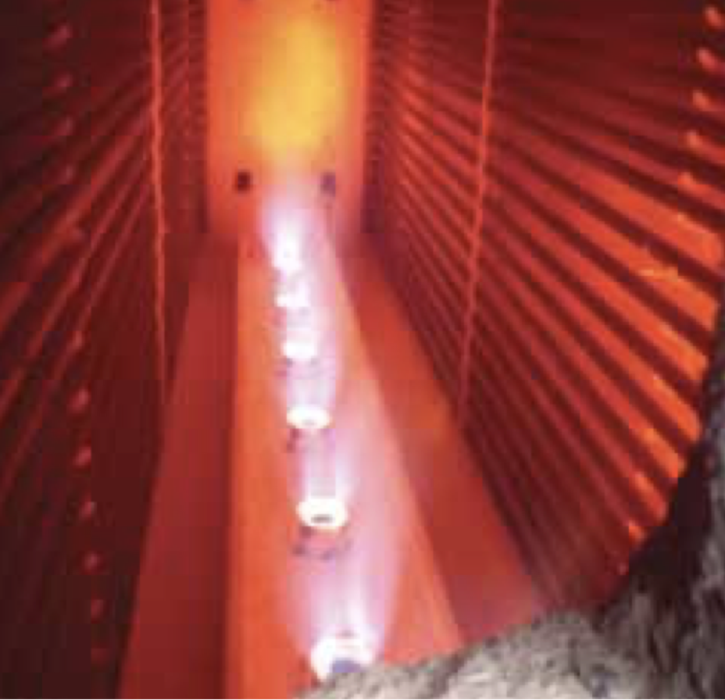
We Live in a Multiphysics World
Fluid/Structure coupling:
Wind turbines
Wing fluttering, etc.
Non-isothermal fluids/participating media radiation:
Fires,
Natural gas and coal combustion,
Smelting, ethylene production, etc.
Conjugate heat transfer:
Object-in-fire
Gas turbine fine cooling
Often times, we note a time and length scale disparity
For example, consider heating a pan on a home burner
The coupling architect must generally choose between monolithic and split
For monolithic, the equations are provided, therefore, the challenge becomes managing a monolithic system solve, storage and code design
For operator split, there can be an “art” in determination of stable couplings due to Eignevalue spread
Intel® Xeon® Processor Scalable Family Thermal Mechanical Specifications and Design Guide
Wing Flutter on a 747
Erwin Platvoet Charles Baukal, P.E. John Zink Hamworthy Combustion

Slide 4
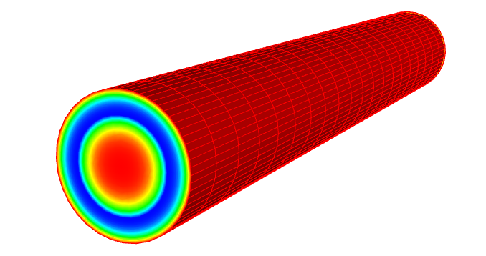
Conjugate Heat Transfer Coupling
Thermal
Common in engineering applications that require efficient heating or cooling of objects
Conduction
Heat Transfer,
Enclosure Radiation
1 DOF/node
+ chemistry
Tb
Temperature
SURFACE
Convection Coef/Temp .
Fluids
Turbulent
Fluid Mechanics,
Combustion
15 dof/node
Tb
Turbulent pipe CHT

Slide 5
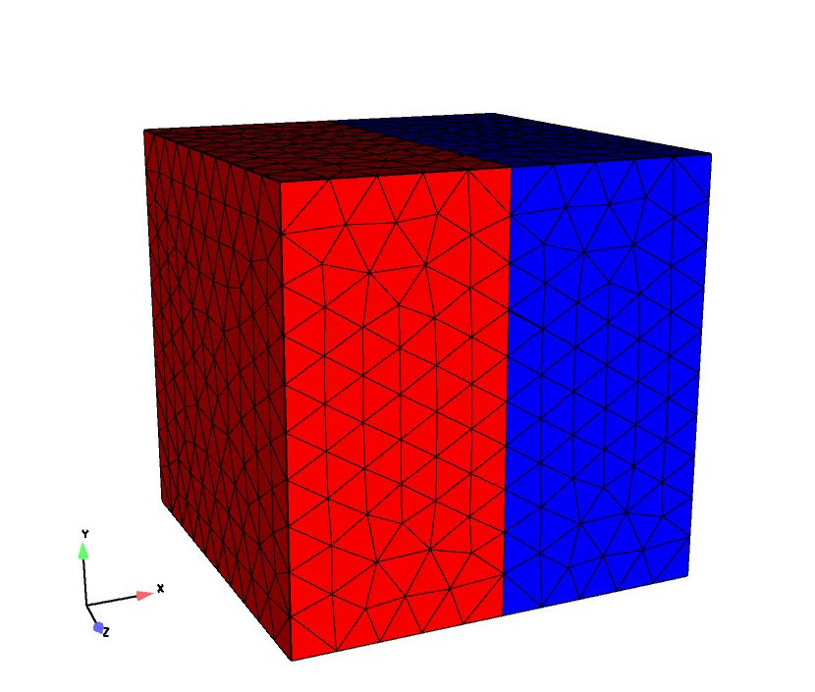
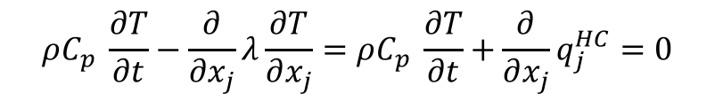
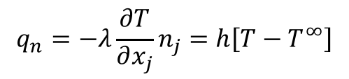
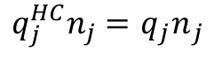
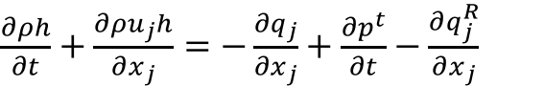
Conjugate Heat Transfer Coupling, Equations
Favre-averaged static enthalpy equation:
Thermal heat conduction
Interface condition
$\frac{∂ρh}{∂t}+\frac{∂ρu_{j}h}{∂x_{j}}$ $=−\frac{∂q_{j}}{∂x_{j}}+\frac{∂p^{t}}{∂t}−\frac{∂q_{j}^{R}}{∂x_{j}}$
$$ρC_{p} \frac{∂T}{∂t}−\frac{∂}{∂x_{j}}λ\frac{∂T}{∂x_{j}}=ρC_{p} \frac{∂T}{∂t}+\frac{∂}{∂x_{j}}q_{j}^{HC}=0$$
$$q_{n}=−λ\frac{∂T}{∂x_{j}}n_{j}=h\left[T−T^{∞}\right]$$
$q_{j}^{HC}n_{j}=$ ${q_{j}n}_{j}$

Slide 6
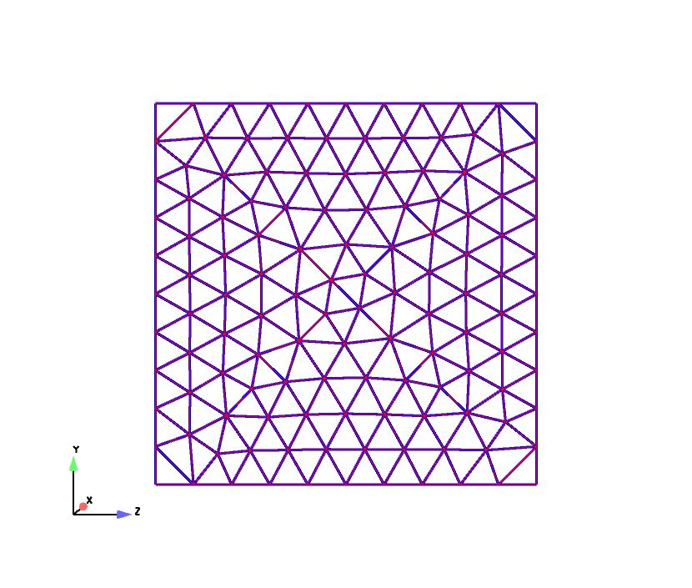

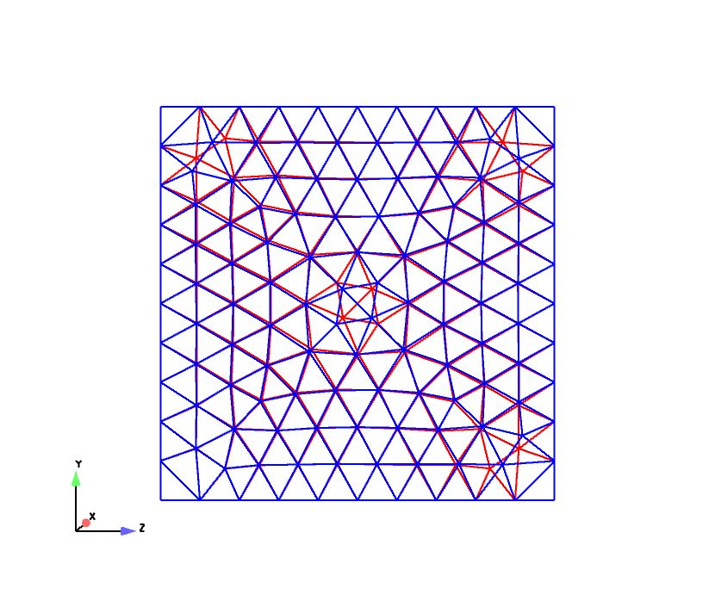
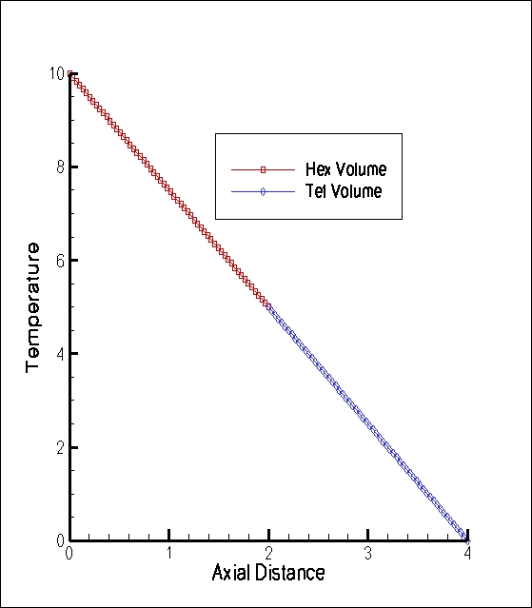
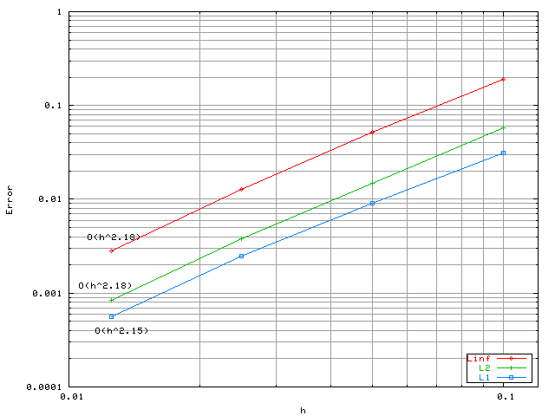
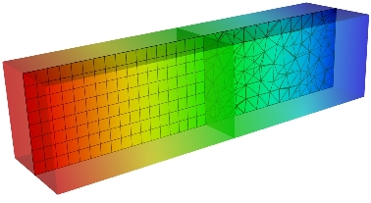
Fluid/CHT Coupling Verification
Unstructured heterogeneous mesh capability
Arbitrary geometric complexity
Multi-block domain variable transfer
Conforming interface
Non-
conforming interface
Linear (patch test)
Trigometric MMS

Slide 7
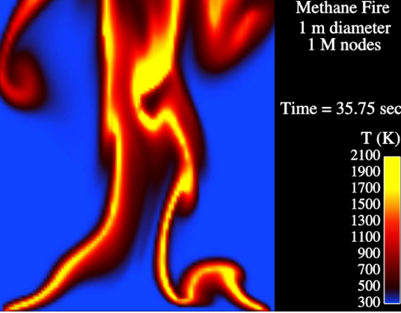
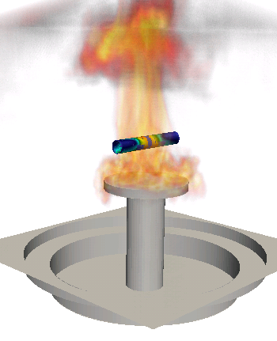
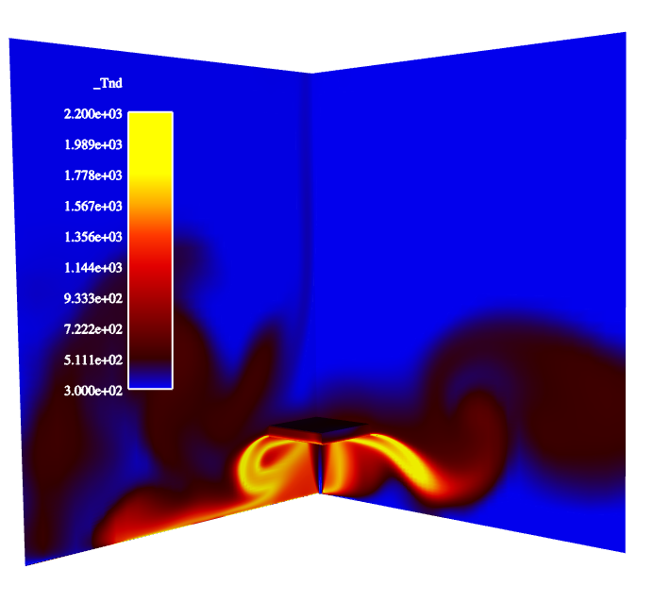
Fluids/PMR Coupling
PMR
Participating
Media
Radiation
n(n+2) DOF/node
T, μ, S_{RTE}
Pool fire
VOLUME
Fluids
Turbulent
Fluid Mechanics,
Combustion
15 dof/node
Deflected reacting jet

Slide 8
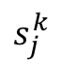
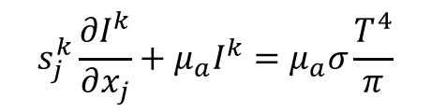
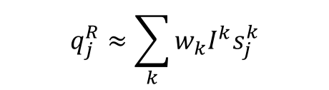


Fluids/PMR Coupling Equations
Favre-averaged static enthalpy equation:
Steady, non-scattering Radiative Transport Equation
Scalar Flux,
Divergence of radiative flux,
$\frac{∂ρh}{∂t}+\frac{∂ρu_{j}h}{∂x_{j}}$ $=−\frac{∂q_{j}}{∂x_{j}}+\frac{∂p^{t}}{∂t}−\frac{∂q_{j}^{R}}{∂x_{j}}$
$$s_{j}^{k}\frac{∂I^{k}}{∂x_{j}}+μ_{a}I^{k}=μ_{a}σ\frac{T^{4}}{π}$$
$$G≈\sum_{k}{w_{k}I^{k}}$$
$$s_{j}^{k}$$
$$q_{j}^{R}≈\sum_{k}{w_{k}I^{k}s_{j}^{k}}$$
$$\frac{∂q_{j}^{R}}{∂x_{j}}=μ_{a}\left[4{σT}^{4}−G\right]$$
Quadrature

Slide 9
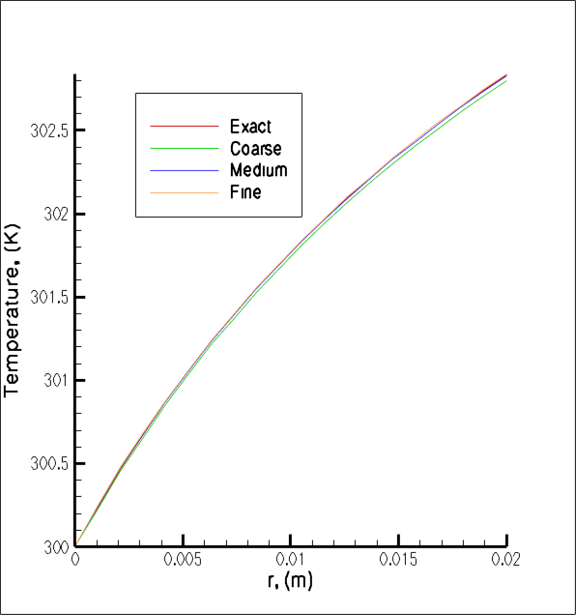
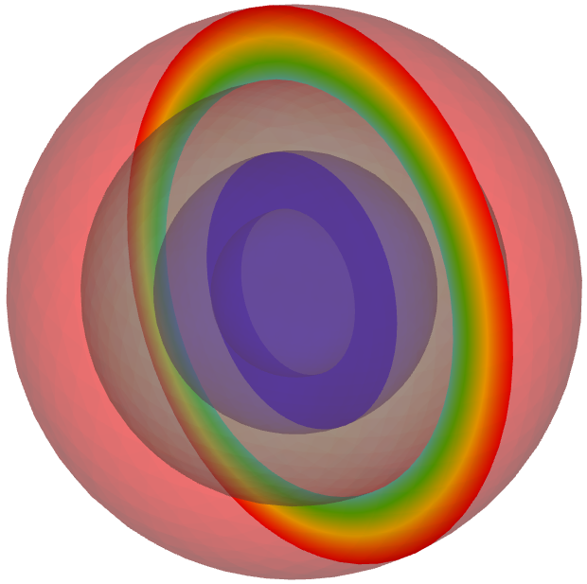
PMR/Thermal Coupling
Thermal
Temperature
PMR
Conduction
Heat Transfer,
Enclosure Radiation
1 DOF/node
+ chemistry
SURFACE
Participating
Media
Radiation
n(n+2) DOF/node
Irradiation
r_{o}, T_{o} = 0.1 m, 600K
r₂, T₂ = 0.075 m, 599.291K
r₁, T₁ = 0.05 m, 302.834K
r_{i}, T_{i} = 0.03 m, 300K
PMR:Conduction through concentric spheres
O(1.8) with faceting,
O(2) without

Slide 10
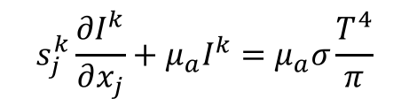
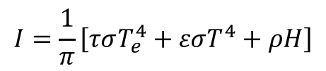
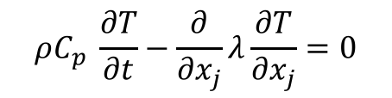
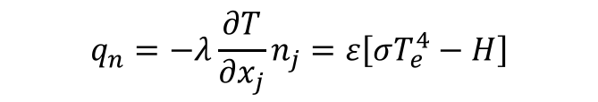
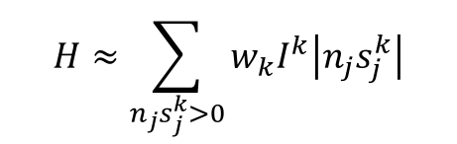
PMR/Thermal Coupling Equations
Steady, non-scattering Radiative Transport Equation
Irradiation (incoming),
Grey, diffuse boundary condition (given transmissivity, τ, emissivity ε, and reflectivity, ρ
With boundary condition,
$$s_{j}^{k}\frac{∂I^{k}}{∂x_{j}}+μ_{a}I^{k}=μ_{a}σ\frac{T^{4}}{π}$$
$$H≈\sum_{n_{j}s_{j}^{k}>0}{w_{k}I^{k}\left|n_{j}s_{j}^{k}\right|}$$
$$I=\frac{1}{π}\left[τσT_{e}^{4}+εσT^{4}+ρH\right]$$
$$q_{n}=−λ\frac{∂T}{∂x_{j}}n_{j}=ε\left[σT_{e}^{4}−H\right]$$
$$ρC_{p} \frac{∂T}{∂t}−\frac{∂}{∂x_{j}}λ\frac{∂T}{∂x_{j}}=0$$

Slide 11
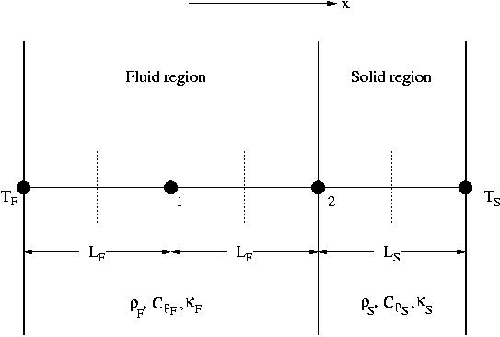
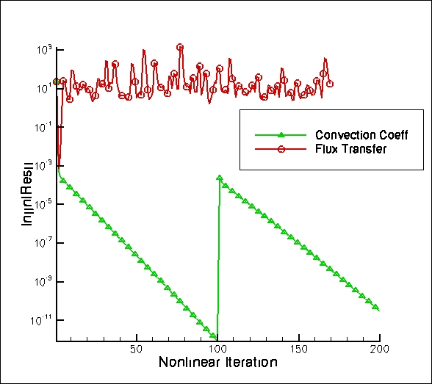
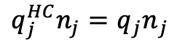
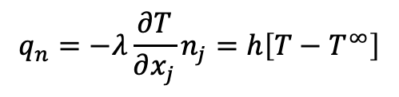
Stability of Operator Split CHT Approaches
Thermal
Compute amplification factor: T^{n+1} = λ T^{n} Require:
CHT via flux transfer:
Unstable for certain Δt and material property ratios
CHT via convection coefficient:
Unconditionally stable, however, Δt error
Conduction
Heat Transfer,
Enclosure Radiation
1 DOF/node
+ chemistry
$q_{j}^{HC}n_{j}=$ ${q_{j}n}_{j}$
$$q_{n}=−λ\frac{∂T}{∂x_{j}}n_{j}=h\left[T−T^{∞}\right]$$
Temperature
SURFACE
Convection Coef/Temp .
T^{spec}
Simplified 1D geometry with 2 nodes for stability analysis of CHT
Fluids
outflow
Turbulent
Fluid Mechanics,
Combustion
15 dof/node
inflow

Slide 12
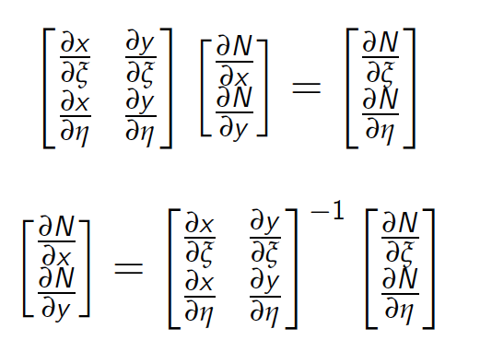
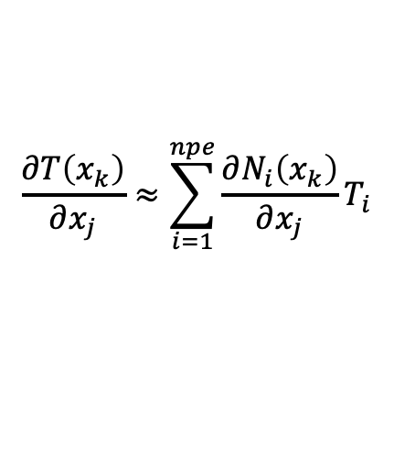
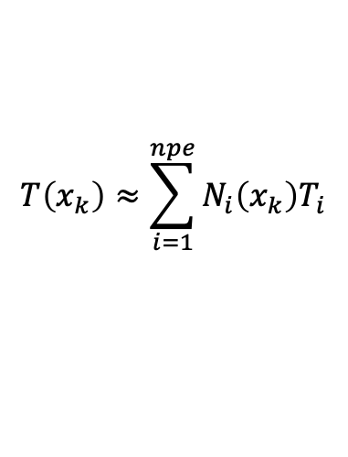
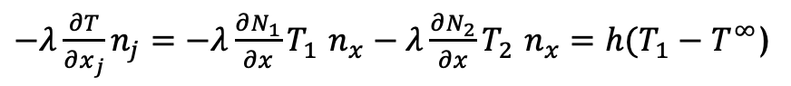
Conjugate Heat Transfer Coupling: In Practice
Using the control volume finite element method (CVFEM) – a Petrov-Galerkin approach
Using a Lagrange polynomial, and definition of element coefficients, interpolation is given by,
While gradients in temperature can be written as,
$$T\left(x_{k}\right)≈\sum_{i=1}^{npe}{N_{i}\left(x_{k}\right)T_{i}}$$
$$\frac{∂T\left(x_{k}\right)}{∂x_{j}}≈\sum_{i=1}^{npe}{{\frac{∂N_{i}\left(x_{k}\right)}{∂x_{j}}T}_{i}}$$
Thermal
1^{A}
1^{F}
Fluid
2
ε
Δx
$−λ\frac{∂T}{∂x_{j}}n_{j}=−λ\frac{∂N_{1}}{∂x}T_{1}$ $n_{x}−λ\frac{∂N_{2}}{∂x}T_{2} n_{x}=h(T_{1}−T^{∞}$)
“on the wall”, T₁ terms collect to h
“off the wall”, T₂ terms collect to T^{oo}

Slide 13
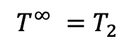
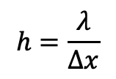
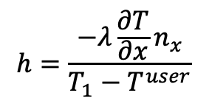
Conjugate Heat Transfer Coupling: Mathematical Construct
Given the definitions of the shape function derivatives on this simple 1D example,
Notes:
Regardless of flow physics, the heat transfer coefficient is always a function of the first mesh spacing
For high convective loads, this approach may not maximize stability of the Aria solve
However, we can arbitrarily increase h and modify T^{oo} consistently to achieve a larger diagonal dominance at the Aria system
We can also allow for h to be based on a physical bulk temperature, e.g., T^{user}
Mandate: Modify the reference temperature and convection coefficient that thermal solution uses to ensure a consistent flux transfer between the CHT interface
$$h=\frac{λ}{∆x}$$
$$T^{∞} =T_{2}$$
$$h=\frac{−λ\frac{∂T}{∂x}n_{x}}{T_{1}−T^{user}}$$

Slide 14
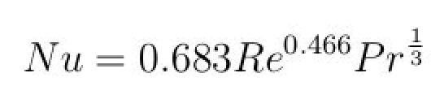
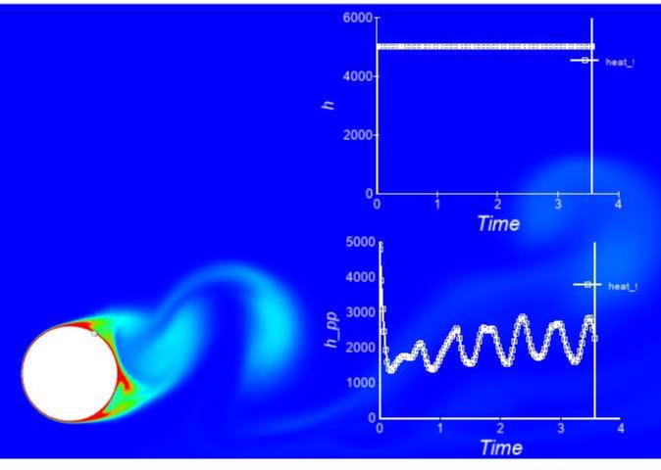
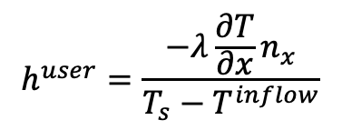
Conjugate Heat Transfer Coupling: Example
Flow past heated cylinder, Re = 1200
Water, T^{cyl} = 300C
Former analysis shows h = 5000 W/(m² K) – fixed while user-based approach would provide ~2000 W/(m² K)
Correlation provides h = 1500 W/(m² K)
Modified post-processing based on inflow temperature
$$h^{user}=\frac{−λ\frac{∂T}{∂x}n_{x}}{T_{s}−T^{inflow}}$$
In this case, using a smaller h would reduce thermal solve’s diagonal dominance, however, would resonate with a typical ChemEngr or MechEngr
lhs += Int w h (T – T^{oo}) dA

Slide 15
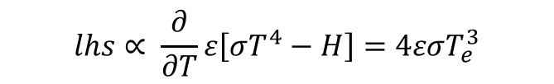
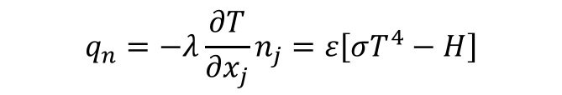
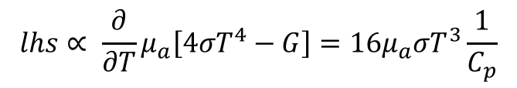

Other Linearization Procedures
PMR and heat conduction radiative boundary condition:
PMR and fluids coupling, linearized divergence of the radiative flux,
In practice, such procedures enhance stability for the multi-physics coupling
In the case of Fluids/CHT, one could possibly monolithically couple the systems
In the case of Fluids/PMR, monolithic coupling is not practical as the intensity system is ~ N², where N is generally O(8)
$$q_{n}=−λ\frac{∂T}{∂x_{j}}n_{j}=ε\left[σT^{4}−H\right]$$
$$lhs∝ \frac{∂}{∂T}ε\left[σT^{4}−H\right]=4εσT_{e}^{3}$$
$$\frac{∂q_{j}^{R}}{∂x_{j}}=μ_{a}\left[4{σT}^{4}−G\right]$$
$$lhs∝ \frac{∂}{∂T}μ_{a}\left[4{σT}^{4}−G\right]=16μ_{a}σT^{3}\frac{1}{C_{p}}$$

Slide 16
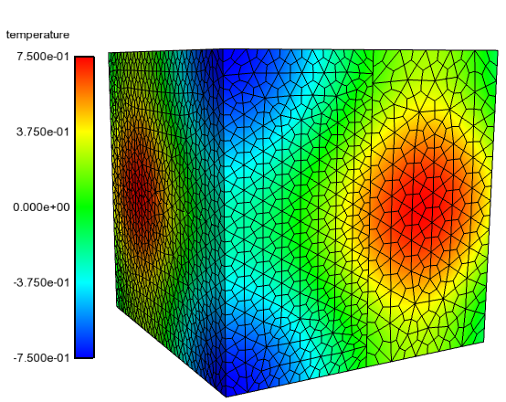
Why not simply monolithic CHT?
In some cases, the thermal response is extremely complex, e.g., includes enclosure radiation, thermal resistance, multiple interior fluids, etc.
For such complex cases, it may be best to operator split
However, if the thermal response is simple, then one might explore a multi-material non-conformal scheme, e.g., Domino, JCP, 2018
Other monolithic opportunities exist
Non-conformal MMS

Slide 17
Multiphysics Coupling: Conclusions
Multiphysics applications are abundant in engineering applications
Turbulent, reacting flow with PMR and CHT requires a wide range of length and time scale resolution
Monolithic approaches are ideal from a splitting perspective, however, can be prohibitively expensive when considering systems such as PMR
Linearization can augment time step stability and should be exploited when possible

Slide 18
Multiphysics Coupling: Conclusions
Multiphysics applications are abundant in engineering applications
Turbulent, reacting flow with PMR and CHT requires a wide range of length and time scale resolution
Monolithic approaches are ideal from a splitting perspective, however, can be prohibitively expensive when considering systems such as PMR
Linearization can augment time step stability and should be exploited when possible
Multiphysics Application
Operator split
Stability
Accuracy
Data transfer
Build system
Time-scale disparity
Monolithic
Efficient solvers
Flexible code design
Non-conformal interfaces
Time-scale disparity

